Slide 1

Reading Input
When a program asks for user input
It should first print a message that tells the user which input is expected
System.out.print("Please enter the number of bottles: "); // Display prompt
This message is called a prompt
Use the print method, not println, to display the prompt
Leave a space after the colon
Use a class called Scanner to read keyboard input.

Slide 2
Reading Input - Scanner
To construct a Scanner object:
Scanner in = new Scanner(System.in);
Use the Scanner's nextInt method to read an integer value:
System.out.print("Please enter the number of bottles: ");
int bottles = in.nextInt();
When the nextInt method is called,
The program waits until the user types a number and presses the Enter key;
After the user supplies the input, the number is placed into the bottles variable;
The program continues.

Slide 3
Reading Input - Scanner
Use the nextDouble method to read a floating-point number:
System.out.print("Enter price: ");
double price = in.nextDouble();
To use the Scanner class, import it by placing the following at the top of your program file:
import java.util.Scanner;

Slide 4
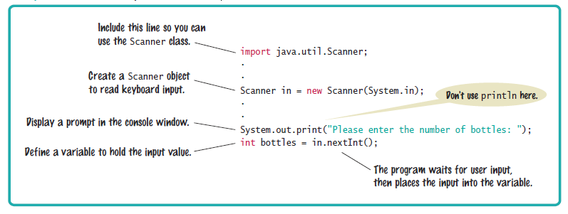
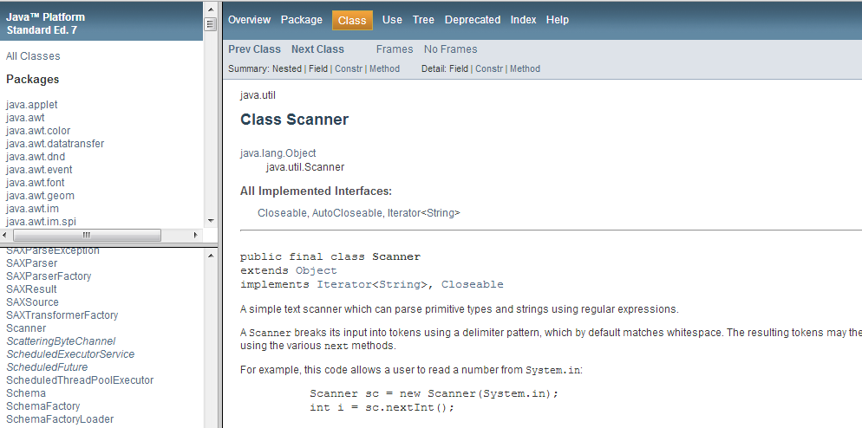
Syntax 4.3 Input Statement
Scanner is a built in java class – take a moment to go take a look at all its methods.
Click here

Slide 5
Formatted Output
Use the printf method to specify how values should be formatted.
printf lets you print this
Price per liter: 1.22
Instead of this
Price per liter: 1.215962441314554
This command displays the price with two digits after the decimal point:
System.out.printf("%.2f", price);

Slide 6
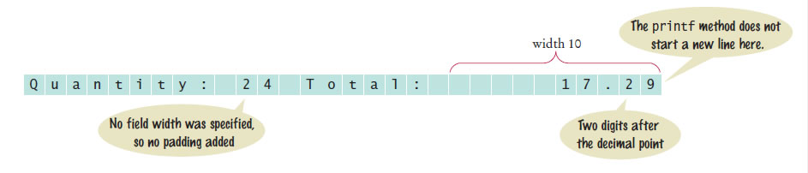
Formatted Output
You can print multiple values with a single call to the printf method.
Example
System.out.printf("Quantity: %d Total: %10.2f",
quantity, total);
Output explained:

Slide 7
Self Check 4.11
Write statements to prompt for and read the user’s age using a Scanner variable named in.
Answer:
System.out.print("How old are you? ");
int age = in.nextInt();

Slide 8
Self Check 4.12
What is wrong with the following statement sequence?
System.out.print("Please enter the unit price: ");
double unitPrice = in.nextDouble();
int quantity = in.nextInt();
Answer: There is no prompt that alerts the program user to enter the quantity.

Slide 9
Self Check 4.13
What is problematic about the following statement sequence?
System.out.print("Please enter the unit price: ");
double unitPrice = in.nextInt();
Answer: The second statement calls nextInt, not nextDouble. If the user were to enter a price such as 1.95, the program would be terminated with an “input mismatch exception”.

Slide 10
Self Check 4.14
What is problematic about the following statement sequence?
System.out.print("Please enter the number of cans");
int cans = in.nextInt();
Answer: There is no colon and space at the end of the prompt. A dialog would look like this:
Please enter the number of cans6

Slide 11
Self Check 4.15
What is the output of the following statement sequence?
int volume = 10;
System.out.printf("The volume is %5d", volume);
Answer:
The total volume is 10
There are four spaces between is and 10. One space originates from the format string (the space between s and %), and three spaces are added before 10 to achieve a field width of 5.

Slide 12
Self Check 4.16
Using the printf method, print the values of the integer variables bottles and cans so that the output looks like this:
Bottles: 8 Cans: 24
The numbers to the right should line up. (You may assume that the numbers have at most 8 digits.)
Answer: Here is a simple solution:
System.out.printf("Bottles: %8d\n", bottles);
System.out.printf("Cans: %8d\n", cans);
Note the spaces after Cans:. Alternatively, you can use format specifiers for the strings. You can even combine all output into a single statement:
System.out.printf("%-9s%8d\n%-9s%8d\n”,
"Bottles: ", bottles, "Cans:", cans);

Slide 13
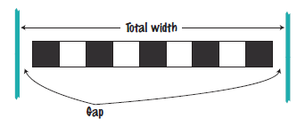
Problem Solving: First Do It By Hand
Very important step for developing an algorithm
Carry out the computations by hand first
Pick concrete values for a typical situation to use in a hand calculation.
Problem: A row of black and white tiles needs to be placed along a wall. First and last are black.
Compute the number of tiles needed and the gap at each end, given the space available and the width of each tile.

Slide 14

Problem Solving: First Do It By Hand
Use numbers
Total width: 100 inches
Tile width: 5 inches
The first tile must always be black,
and then we add some number of white/black pairs:

Slide 15
Problem Solving: First Do It By Hand
The first tile takes up 5 inches, leaving 95 inches to be covered by pairs.
Each pair is 10 inches wide.
The number of pairs needed is 95 / 10 = 9.5.
Discard the fractional part.
We need 9 tile pairs or 18 tiles, plus the initial black tile => 19 tiles.
Tiles span 19 × 5 = 95 inches
Gap is 100 – 19 × 5 = 5 inches
Distribute the gap at both ends
gap is (100 – 19 × 5) / 2 = 2.5 inches

Slide 16
Problem Solving: First Do It By Hand
Devise an algorithm with arbitrary values for the total width and tile width.
The pseudocode
number of pairs = integer part of (total width - tile width) / (2 x tile width)
number of tiles = 1 + 2 x number of pairs
gap at each end = (total width - number of tiles x tile width) / 2

Slide 17
Self Check 4.17
Translate the pseudocode for computing the number of tiles and the gap width into Java.
Answer:
int pairs = (totalWidth - tileWidth) / (2 * tileWidth)
int tiles = 1 + 2 * pairs;
double gap = (totalWidth - tiles * tileWidth) / 2.0;
Be sure that pairs is declared as an int.

Slide 18
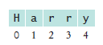
Strings and Characters
String positions are counted starting with 0.
The position number of the last character is always one less than the length of the string.
The last character of the string "Harry" is at position 4
The charAt method returns a char value from a string
The example
String name = "Harry”;
char start = name.charAt(0);
char last = name.charAt(4);
Sets start to the value 'H' and last to the value 'y'.

Slide 19
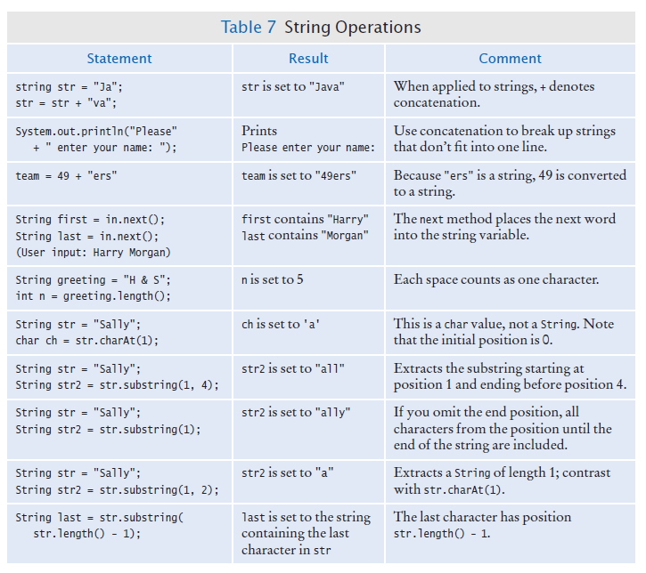
String Operations

Slide 20
Self Check 4.22
What is the length of the string "Java Program"?
Answer: The length is 12. The space counts as a character.

Slide 21
Self Check 4.23
Consider this string variable
String str = "Java Program";
Give a call to the substring method that returns the substring "gram".
Answer:
str.substring(8, 12)
or
str.substring(8)

Slide 22
Self Check 4.24
Use string concatenation to turn the string variable str from Self Check 23 into "Java Programming".
Answer:
str = str + "ming”;

Slide 23
Self Check 4.25
What does the following statement sequence print?
String str = "Harry”;
int n = str.length();
String mystery = str.substring(0, 1) +
str.substring(n - 1, n);
System.out.println(mystery);
Answer:
Hy

Slide 24
Self Check 4.26
Give an input statement to read a name of the form “John Q. Public”.
Answer:
String first = in.next();
String middle = in.next();
String last = in.next();

